Slide 1

Development of a smell synthesis system using machine learning
Masahito Kumada
Notes:
Hello, everyone. I’m Masahito Kumada.
I am working on Development of a smell synthesis system using machine learning for my master's degree.
Today, I’m taking about this.

Slide 2



Motivation
Nose
Tougue
VS
components of taste.
Quantify and analyze smells and create a new system.
Notes:
We usually perceive smells and tastes through our nose and tongue.
And, we know components of taste like on the other hand, we don‘t even know what constitutes a smell .
In other words, the components of smell are not well understood, and until recently, it has not been possible to quantify them.

Slide 3
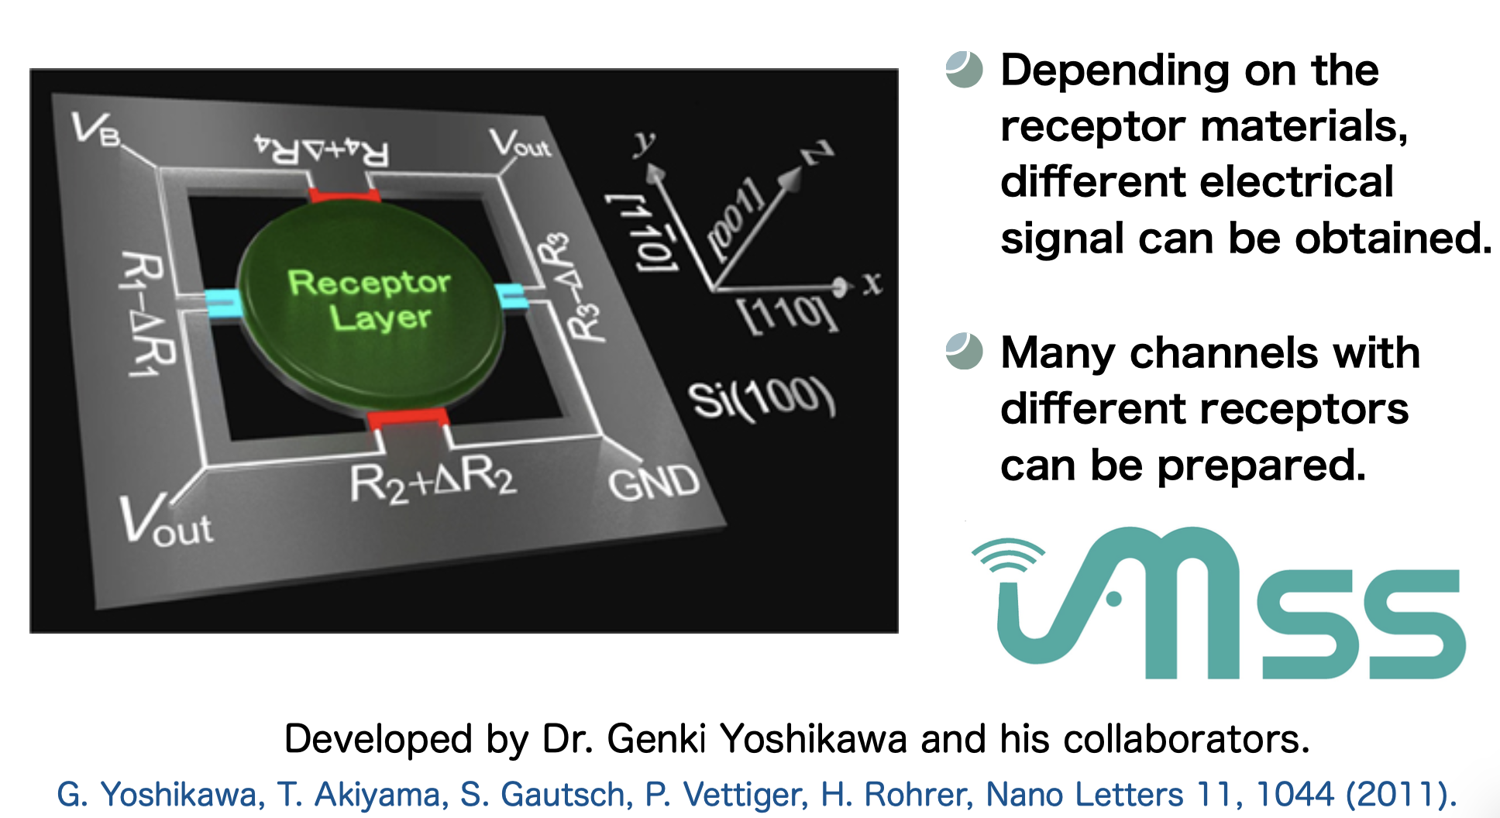
Special tools used for my research
Membrane-type Surface stress Sensor
Notes:
Recently, a device called MSS has been developed that can quantify odors as a vector.
Using this device, it is now possible to quantitatively analyze the ratio of the odor of one substance to another in order to synthesize the odor of one or more substances.

Slide 4
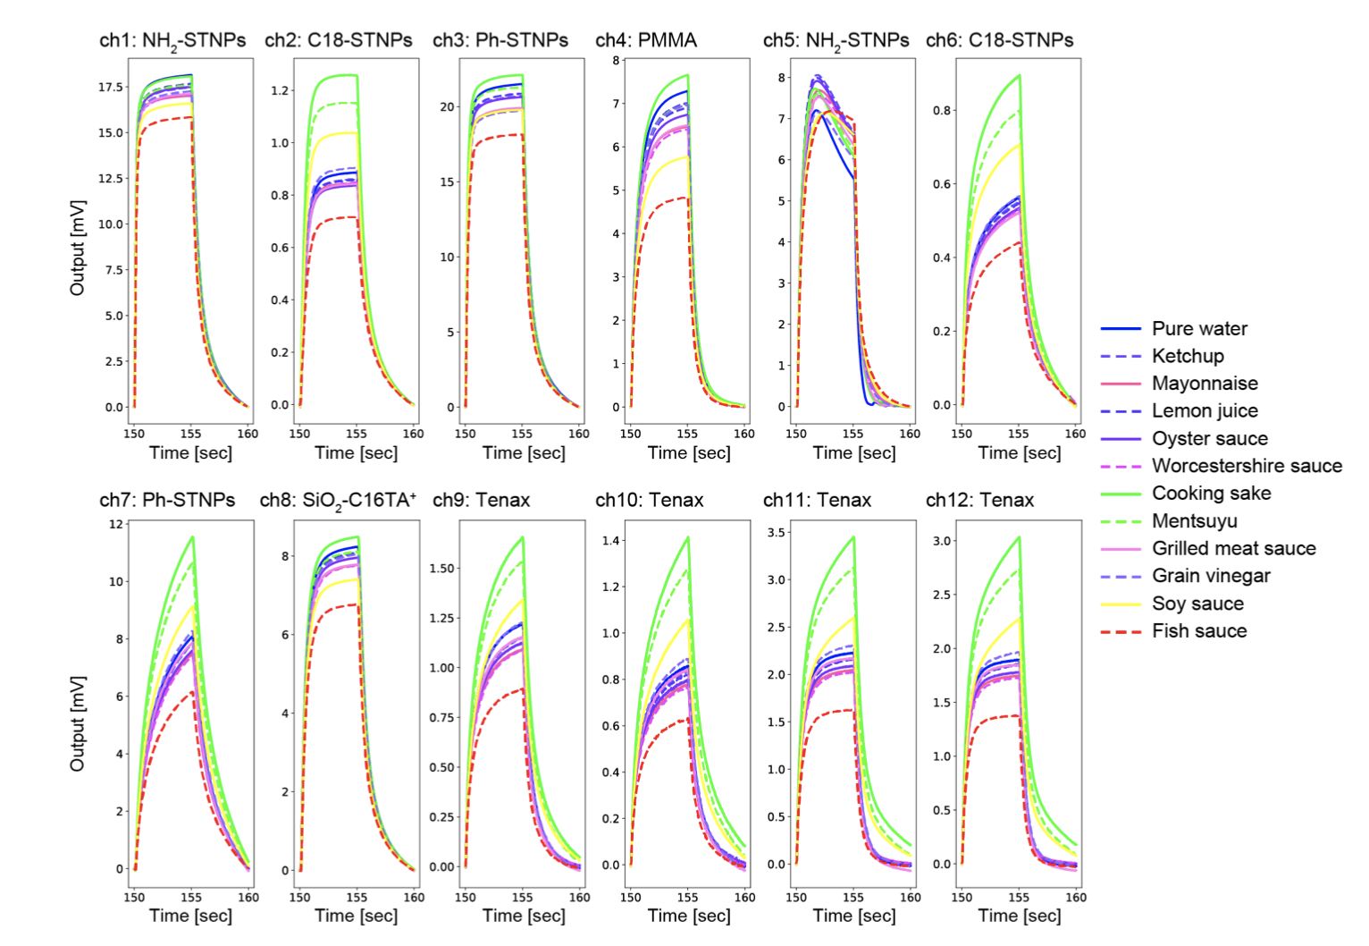
Special tools used for my research
Measuring a smell of seasonings with MSS...
Notes:
In fact if we measure a smell of seasonigs with MSS, it can be seen that the signal response is different depending on the odor.
It show the figure below.
This means that by analyzing the signal response using mss, we may be able to identify the odor quantitatively.
Also Mixing the odors of multiple substances in a fixed ratio and synthesizing the odor of another substance is important because it can reproduce the odor of rare substances from several existing inexpensive substances.
Since previous studies have not been able to quantify the odor of substances, they have used empirical methods to determine the range of substances that can be synthesized through changes in the mixing ratio.

Slide 5
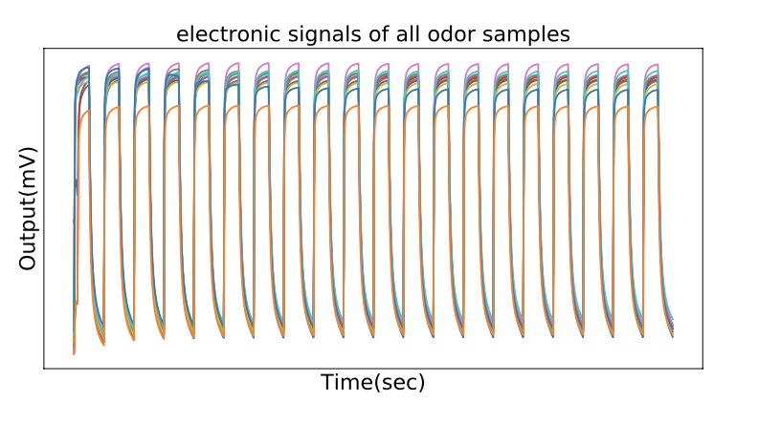
METHDOLOGY
Flow of odor synthesis by multiple pseudo-origin odors
1.There is a MSS signal for the odor you want to make.
2. Start with only solvent
3. Given M pseudo-origin odors, at what concentration can we mix them to reproduce the MSS signal of the odor we want to produce?
4. Candidate pseudo-origin odors to mix next and how much to add.
For 2,
MSS signals in real time
Notes:
So, using mss, I’d like to develop a smell synthesis system using machine learning.
1.There is a MSS signal for the odor you want to make. (The signal of liquid combined with some kind of solvent)
2. Start with only solvent (MSS signal is available in real time)
3. Given M pseudo-origin odors, at what concentration can we mix them to reproduce the MSS signal of the odor we want to produce?
4. Candidate pseudo-origin odors to mix next and how much to add.
5. We want to make machine learning based algorithm to achieve this.

Slide 6
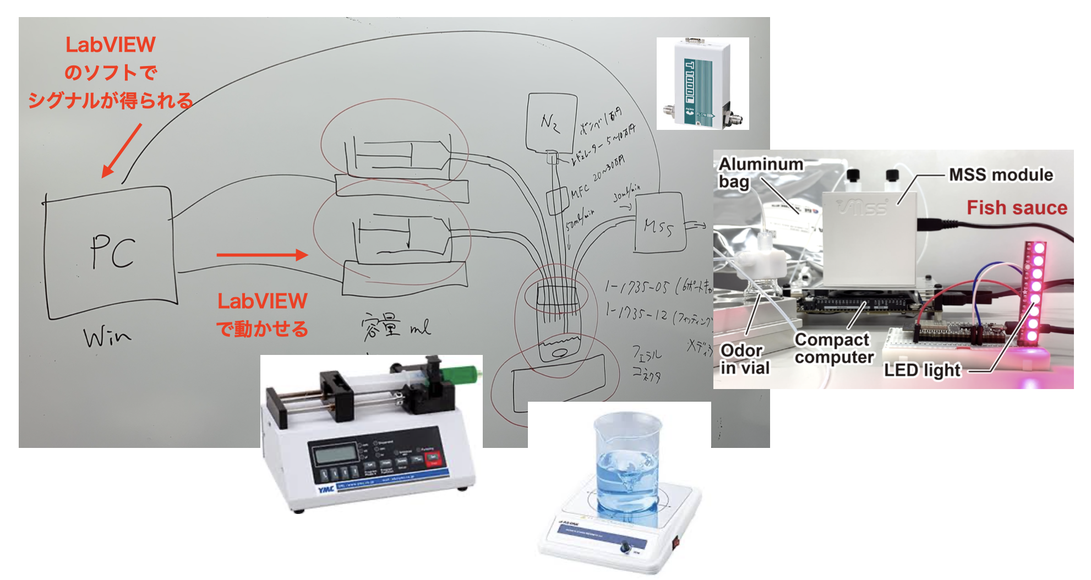
Smell synthesis system using multiple pseudo-origin odors
Notes:
In detail:
It is not easy to develop a general-purpose algorithm for adjusting mixing ratios when synthesizing the odor of a target substance, because the mixing ratio changes accordingly when the substances to be mixed are different. For example, to synthesize the odor of substance G, consider the case where substances A, B, and C are mixed together, and the case where substance D, which is different from substance C, is used to synthesize the odor of substance G from substances A, B, and D. Even if the substance to be mixed is changed, the mixing ratio is different, and it is not yet known how to quantitatively understand the relationship between a method to synthesize substance G from substances A, B and C and a method to synthesize substance G from substances A, B and D.
In this study, I plan to develop a system for adjusting the mixing ratio using machine learning to synthesize the odor of a target substance, even if the substances to be mixed are different.
Contributiuon:
Once this system is complete, we will be able to synthesize the odor of expensive substances from the odor of cheaply available substances.

Slide 7
Virtual experiments on a simulator
Policy
Basic Policy：
Select one of materials A, B, or C and add 1 ml to each Randall.
Additional Policy：
SCALE_FACTOR(0.1)*1 ml is added when the error of the objective function
is less than THRESHOLD_VAL(0.5), SCALE_FACTOR(0.1)*1 ml is added.
Goal：
The search succeeds when the error with the objective function is less
than MIN_VAL(1e-2).
Notes:
We created a simple algorithm because we wanted to experiment the experimental process we have been talking about on the simulation first.

Slide 8
Virtual experiments on a simulator
Result
Random
Bayesian optimization
measurement error
Trial Number
Notes:
It can be seen that the algorithm I devised has a smaller error and requires fewer trials before a certain accuracy is obtained.
When the number of trials is small and the mixing ratio can be obtained, the benefit is that the original material is not wasted.
Future Works:
For example, you can add up to 5 materials at a time.
For example, you can add up to 5 materials at a time.
The total amount of material added should be limited.

Slide 9
Reference
MSS: G. Yoshikawa, T. Akiyama, S. Gautsch, P. Vettiger, H. Rohrer, Nano Letters 11, 1044
COMBO: https://www.comtec.daikin.co.jp/SC/images/COMBO-1-s2.0-S2352924516300035-main.pdf
github: https://github.com/tsudalab/combo

